Slide 1

Quantum Cryptography
from basics of quantum mechanics to secure key distribution
Christoph Hamsen
Berlin Crypto Meetup
May contain traces of atom and quantum optics!

Slide 2


Who am I?
Studied Physics @ TU Ilmenau, MIT, TU Munich and Harvard
Researched on quantum optics for PhD @ MPQ
Developed software for robots @ Magazino
Bringing IT security to software @ SSE
Podcasts enthusiast (Logbuch Netzpolitik, Lage der Nation) and frequent visitor to c3!
The speaker is not a cryptographer!

Slide 3

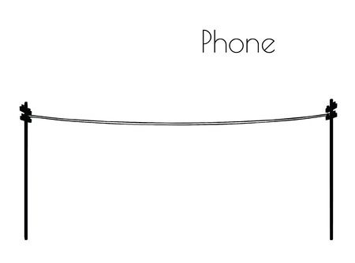
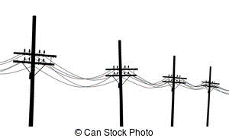

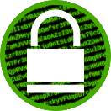



Cryptography and Key Distribution
Eve
Alice
Bob
How to securely exchange the key?
Communication should be secure!
Authentic
Confidential
Integrity
Choose Transport Layer Security (TLS)!
v1.2 or higher!
Select Cipher suite
Key Exchange
Encryption
DHE – RSA – AES128 – SHA256
DHE – RSA – AES128 – SHA256
Authentication
Message Authentication
Only computationally secure
$→$ Quantum Key Distribution offers physical security

Slide 4
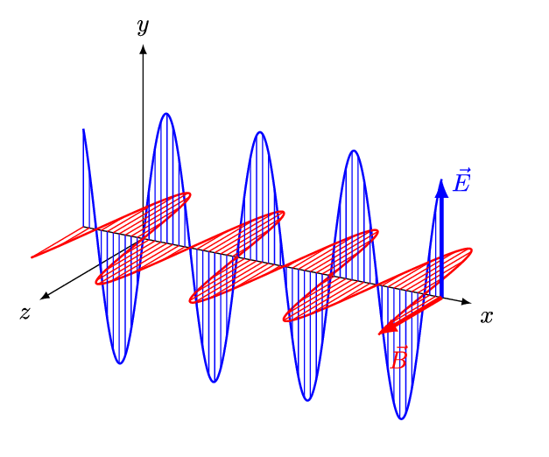
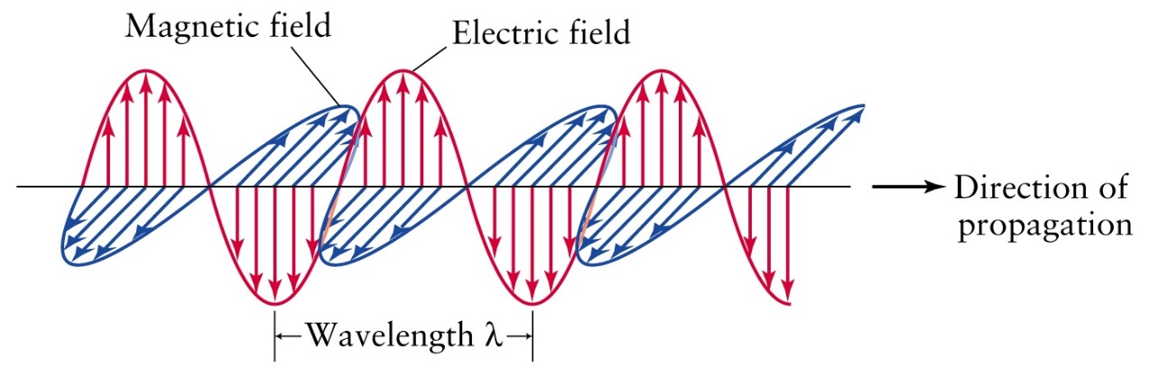
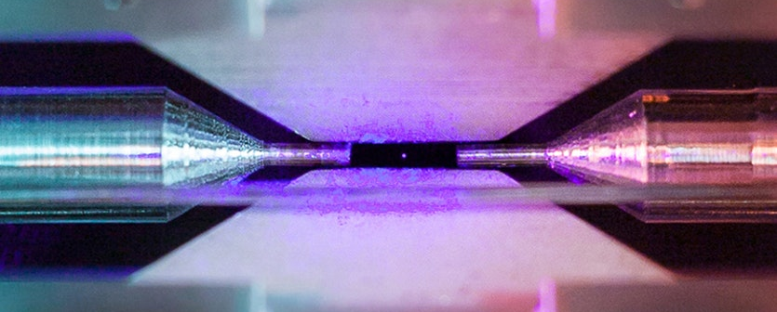
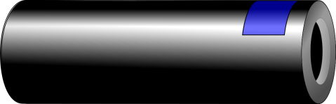
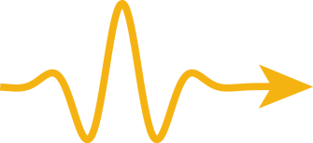


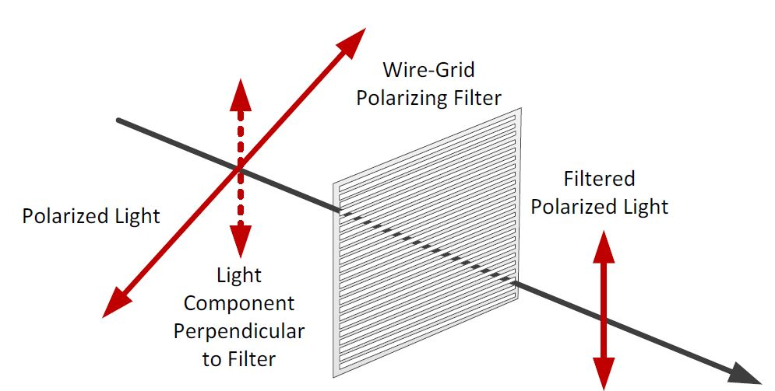

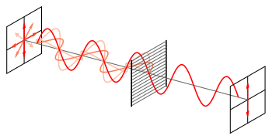
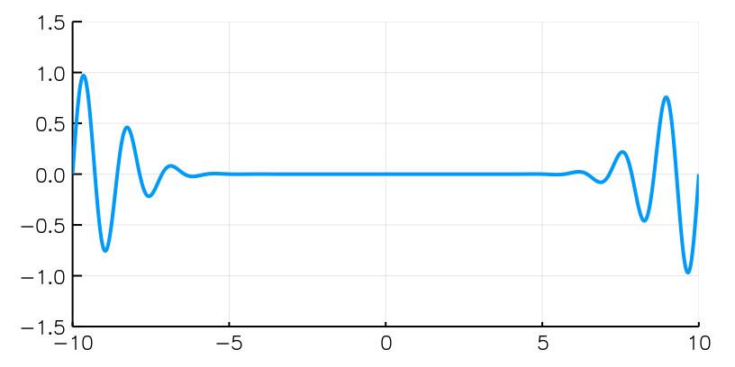
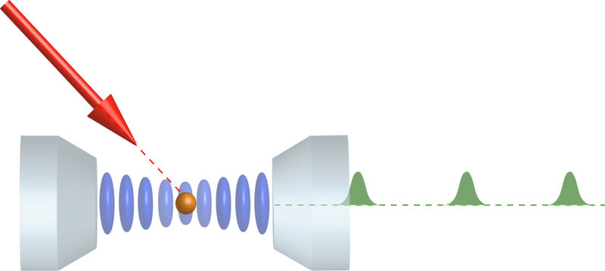
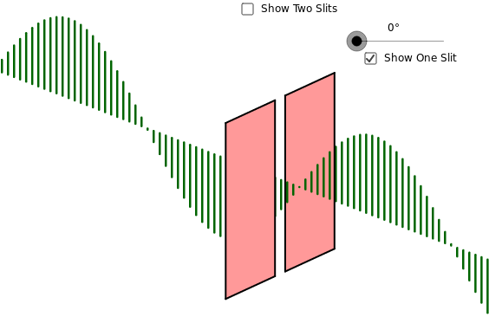
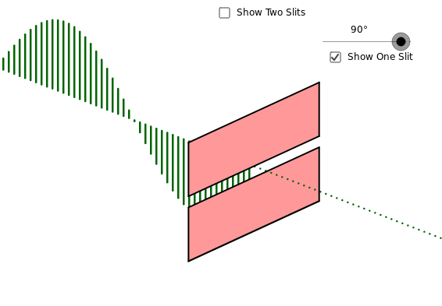
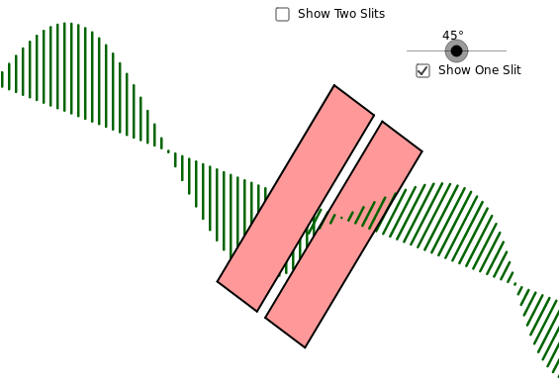

Enter the photon!
$≈$ Polarization
< 1900: Light is a wave!
> 1900: Light consists of particles (photons)
> 1980: First single-photon sources
Photon cannot be split!
Measurements are irreversible.
Polarizer
Transmission:
Probability:
100%
0%
50%
Image sources:
David Nadlinger @ Ion Trap Quantum Computing Group at University of Oxford
Rempe Group @ Max Planck Institute of Quantum Optics
Image sources: Anton Paar (wiki.anton-paar.com), oPhysics.com, Wikipedia

Slide 5
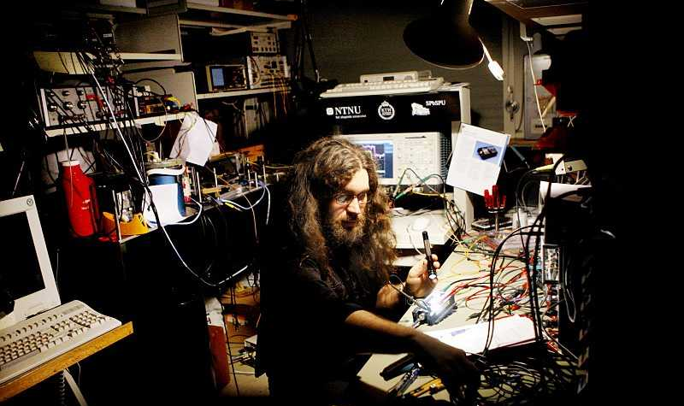
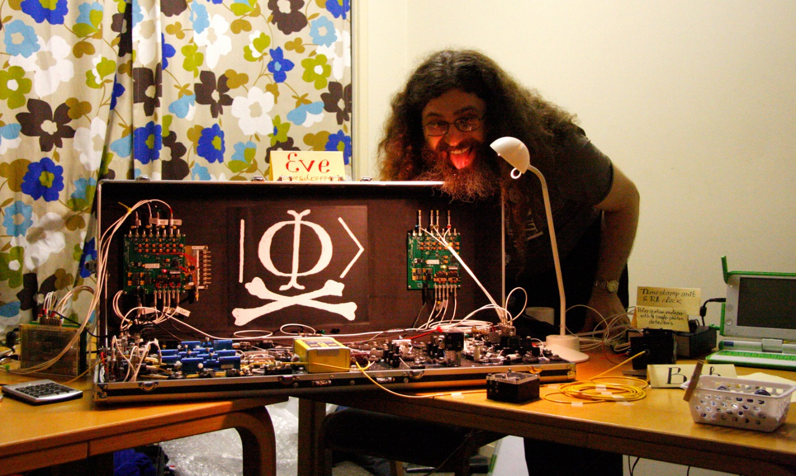







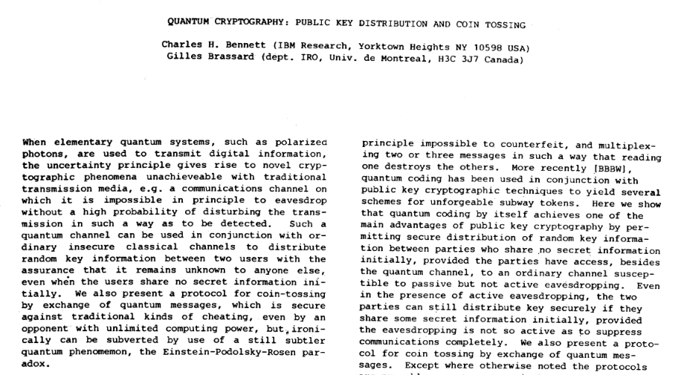
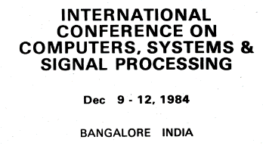

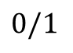
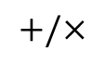
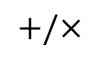
Quantum Key Distribution
á la “BB84”
Alice
Eve
Bob
RNG
$$+/×$$
RNG
$$+/×$$
1
1
0
1
0
0
1
1
0
1
0
1
RNG
$$0/1$$
h/v basis
diag. basis
Vadim Makarov – Quantum Hacker
1
0/1
0/1
0/1
0
0
0/1
1
0/1
1
0
0/1
“No-cloning theorem”
Protocol:
Alice sends random values in random bases
Bob measures in random bases
Alice communicates chosen bases via classical channel
Both compare random subset of values
Provably secure!
1
0/1
0/1
0/1
0/1
0/1
0/1
1
0/1
0/1
0
0/1
“0”
“1”
“0”
“1”
25% error rate on comparison
Source: http://www.vad1.com/

Slide 6

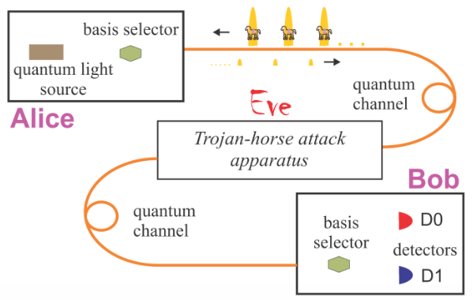


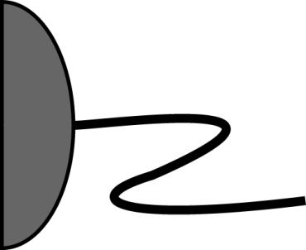



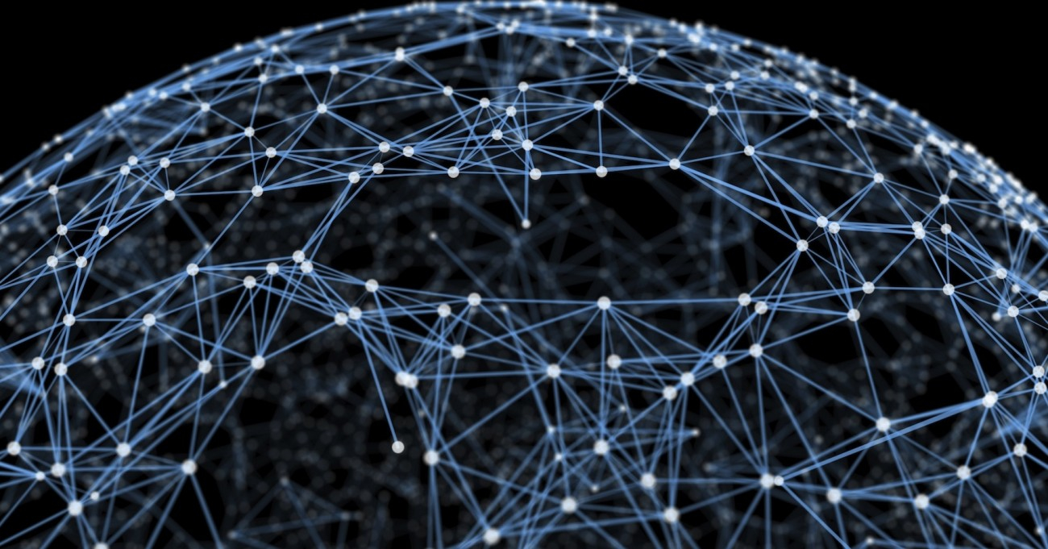
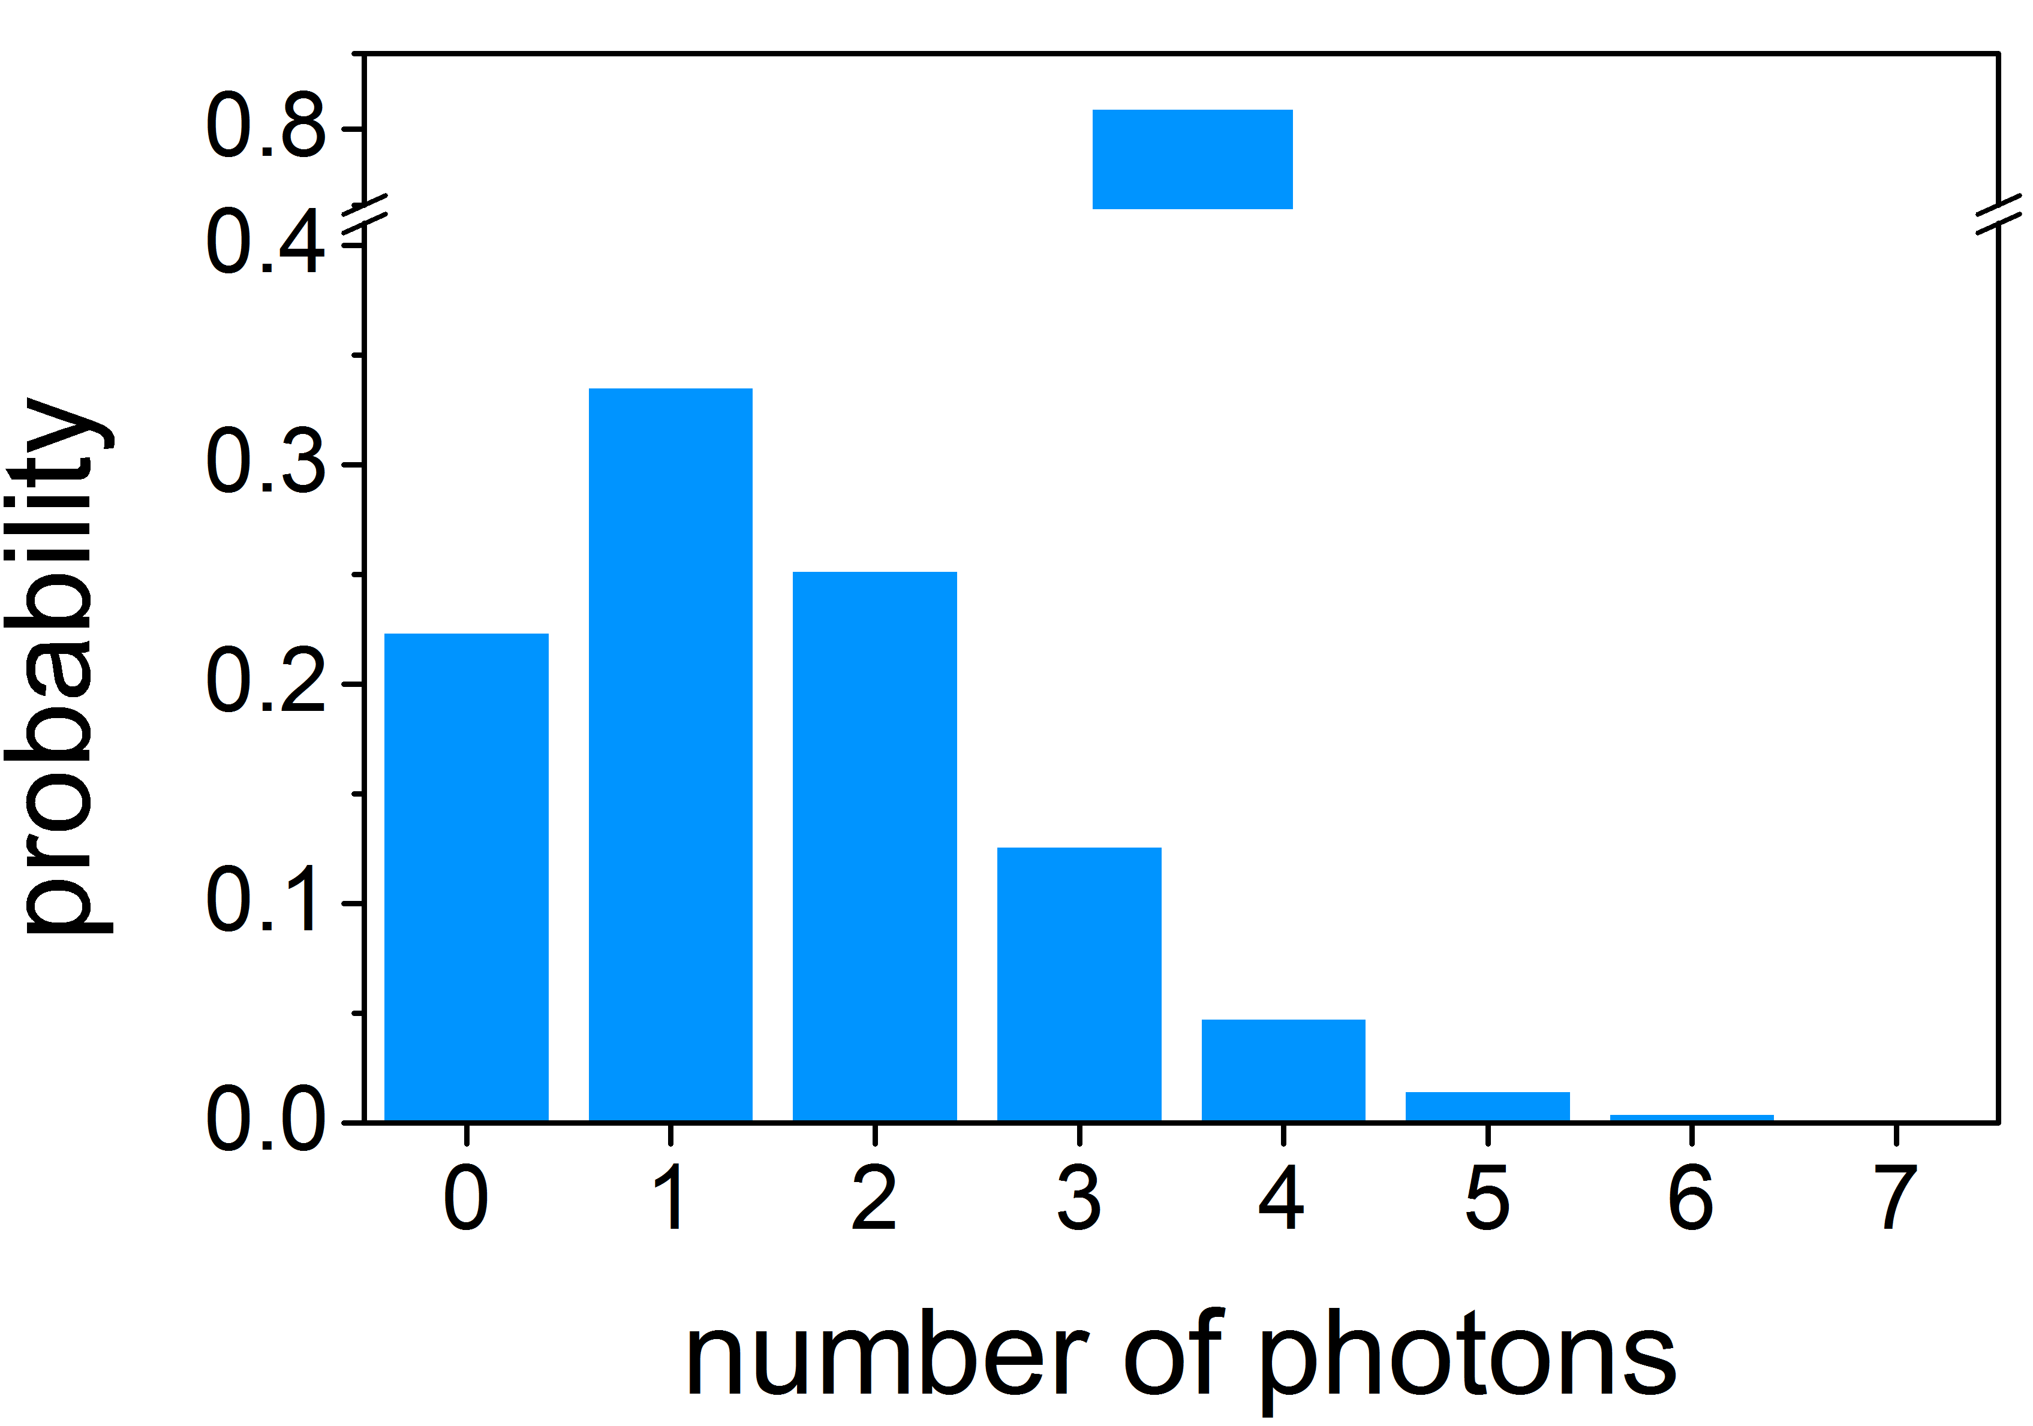
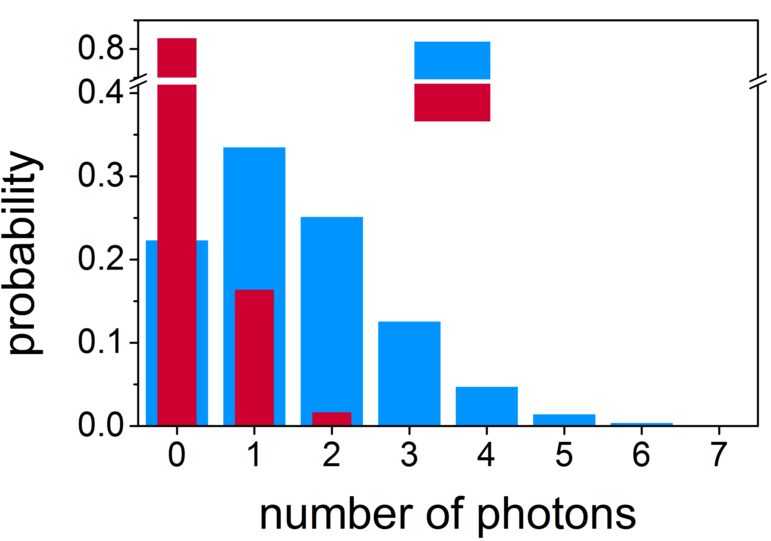


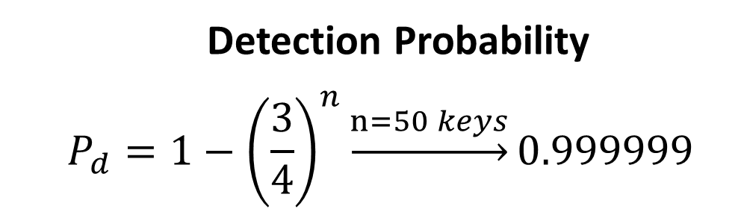
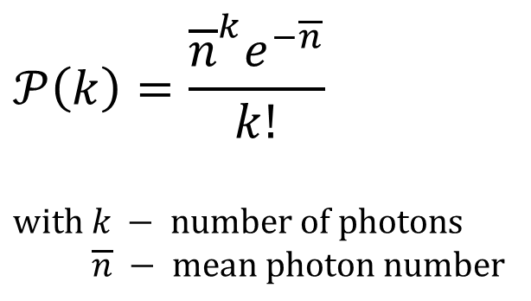
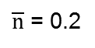
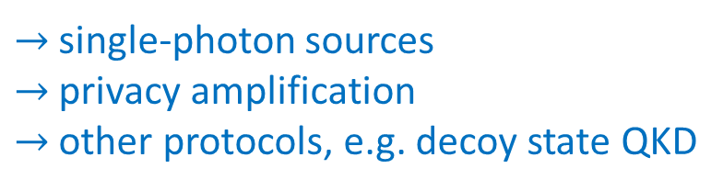
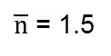
Attacks & Vulnerabilities
Intercept and Resend
Denial of Service
Photon Number Splitting
Trojan Horse
Detection Probability
$$P_{d}=1−{\left(\frac{3}{4}\right)}^{n}\underset{→}{n=50 keys}0.999999$$
Poisson distribution
$\overline{n}$ = 1.5
$$𝒫\left(k\right)=\frac{{\overline{n}}^{k}e^{−\overline{n}}}{k!}$$
$$with k − number of photons$$
$$\overline{n} − mean photon number$$
$\overline{n}$ = 0.2
Bob
Alice
$→$ single-photon sources
$→$ privacy amplification
$→$ other protocols, e.g. decoy state QKD
_____________________________________________________
N. Jain, B. Stiller, I. Khan, V. Makarov, C. Marquardt and G. Leuchs,
"Risk Analysis of Trojan-Horse Attacks on Practical Quantum Key Distribution Systems“,
IEEE 21 (3), 168-177 (2015)
Original source unclear

Slide 7
Hardware/Implementation attacks
Attack | Target component | Tested system
Intersymbol interference | intensity modulator in Alice | research system
K. Yoshino et al., poster at QCrypt (2016)
Laser damage | any | ID Quantique, research system
V. Makarov et al., Phys. Rev. A 94, 030302 (2016)
Spatial efficiency mismatch | receiver optics | research system
M. Rau et al., IEEE J. Quantum Electron. 21, 6600905 (2015); S. Sajeed et al., Phys. Rev. A 91, 062301 (2015)
Pulse energy calibration | classical watchdog detector | ID Quantique
S. Sajeed et al., Phys. Rev. A 91, 032326 (2015)
Trojan-horse | phase modulator in Alice | SeQureNet
I. Khan et al., presentation at QCrypt (2014)
Trojan-horse | phase modulator in Bob | ID Quantique
N. Jain et al., New J. Phys. 16, 123030 (2014); S. Sajeed et al., arXiv:1704.07749
Detector saturation | homodyne detector | SeQureNet
H. Qin, R. Kumar, R. Alleaume, Proc. SPIE 88990N (2013)
Shot-noise calibration | classical sync detector | SeQureNet
P. Jouguet, S. Kunz-Jacques, E. Diamanti, Phys. Rev. A 87, 062313 (2013)
Wavelength-selected PNS | intensity modulator | (theory)
M.-S. Jiang, S.-H. Sun, C.-Y. Li, L.-M. Liang, Phys. Rev. A 86, 032310 (2012)
Multi-wavelength | beamsplitter | research system
H.-W. Li et al., Phys. Rev. A 84, 062308 (2011)
Deadtime | single-photon detector | research system
H. Weier et al., New J. Phys. 13, 073024 (2011)
Channel calibration | single-photon detector | ID Quantique
N. Jain et al., Phys. Rev. Lett. 107, 110501 (2011)
Faraday-mirror | Faraday mirror | (theory)
S.-H. Sun, M.-S. Jiang, L.-M. Liang, Phys. Rev. A 83, 062331 (2011)
Detector control | single-photon detector | ID Quantique, MagiQ, research system
I. Gerhardt et al., Nat. Commun. 2, 349 (2011); L. Lydersen et al., Nat. Photonics 4, 686 (2010)
Table by V.Makarov: http://www.vad1.com/
$→$need hardening of components and implementation!

Slide 8
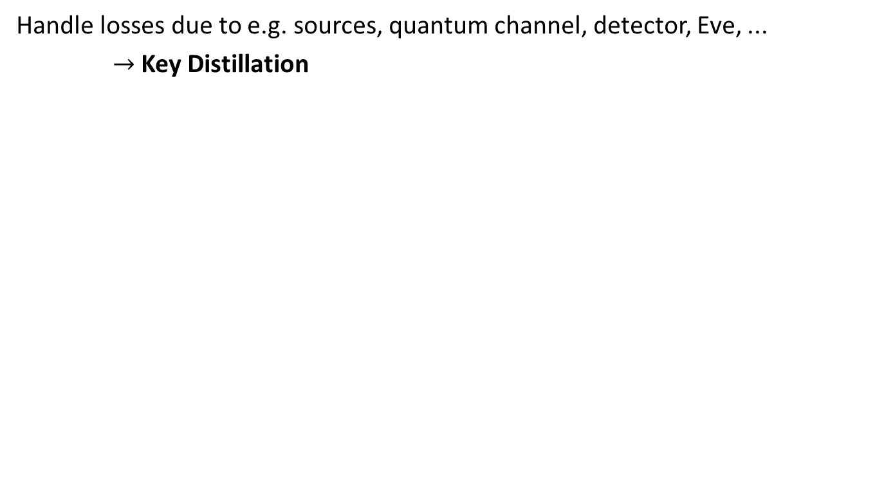
Real world QKD
Handle losses due to e.g. sources, quantum channel, detector, Eve, ...
$→$ Key Distillation
Alice
Bob
Quantum channel
Trans. photons
Public channel
Raw key
Basis reconciliation
Subset comparison
Error correction
Privacy amplification
Key!
Key!
$→$ Transmission losses ultimately limit QKD distance!

Slide 9
“Applications”
Many research groups world-wide
Components
Theory
Commercial systems
IDQuantique, MagiQ Technologies, QuintessenceLabs, SeQureNet, …
Several long-distance test networks…

Slide 10
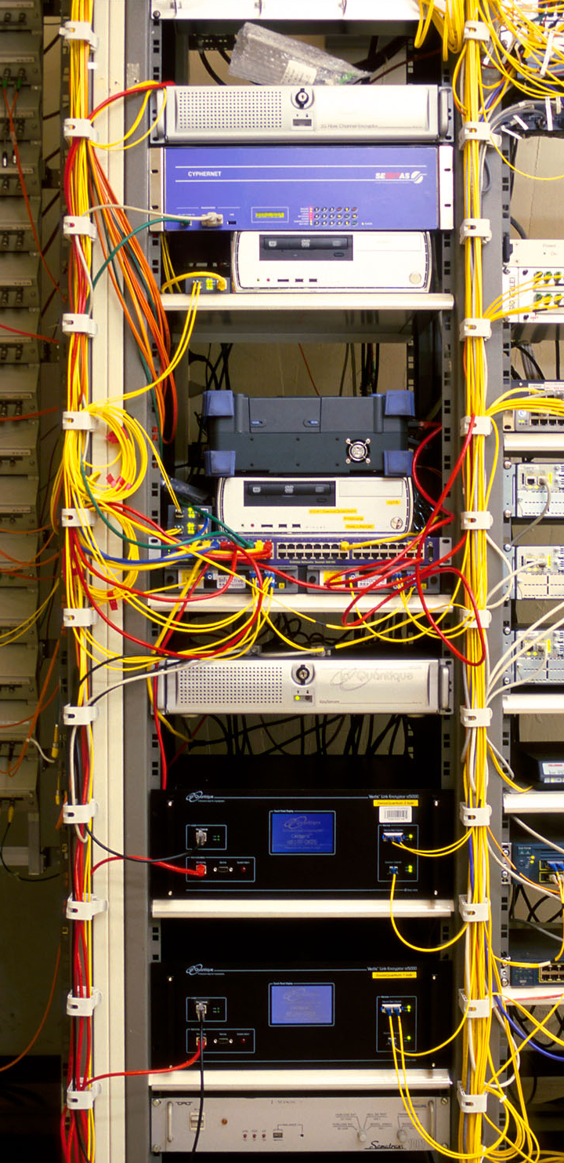
Slide taken from V.Makarov (http://www.vad1.com/)
Classical encryptors:
L2, 2 Gbit/s
L2, 10 Gbit/s
L3 VPN, 100 Mbit/s
WDMs
17 km (fiber length)
Key manager
14 km
QKD to another node
(4 km)
QKD to another node
(14 km)
4 km
www.swissquantum.com
ID Quantique Cerberis system (2010)

Slide 11
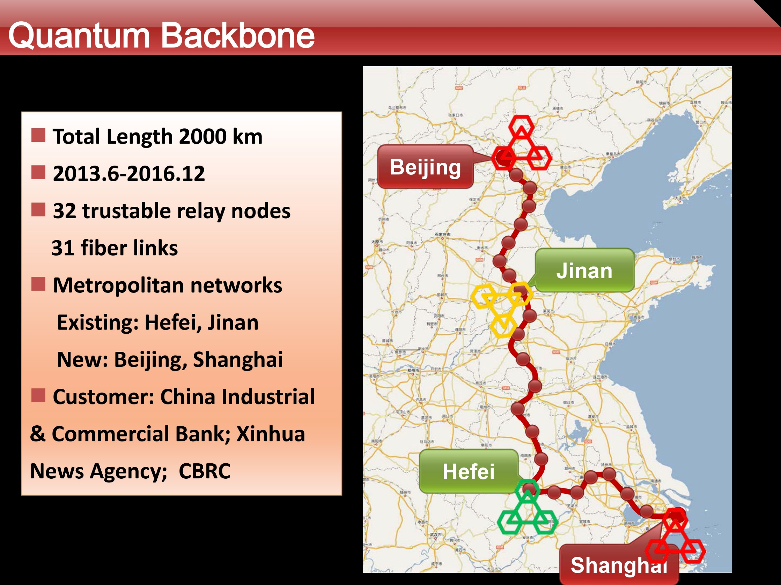
Q. Zhang, talk at QCrypt 2014
Slide taken from V.Makarov (http://www.vad1.com/)

Slide 12
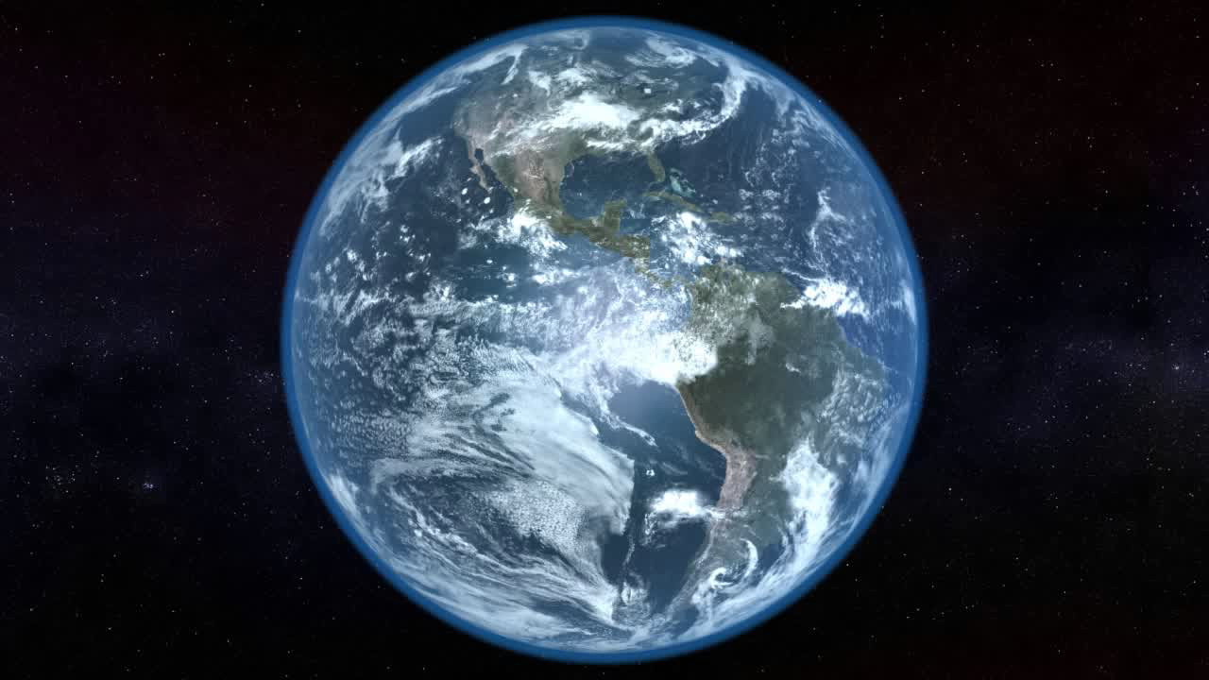
Global quantum key distribution
Slide adapted from V.Makarov (http://www.vad1.com/)

Slide 13
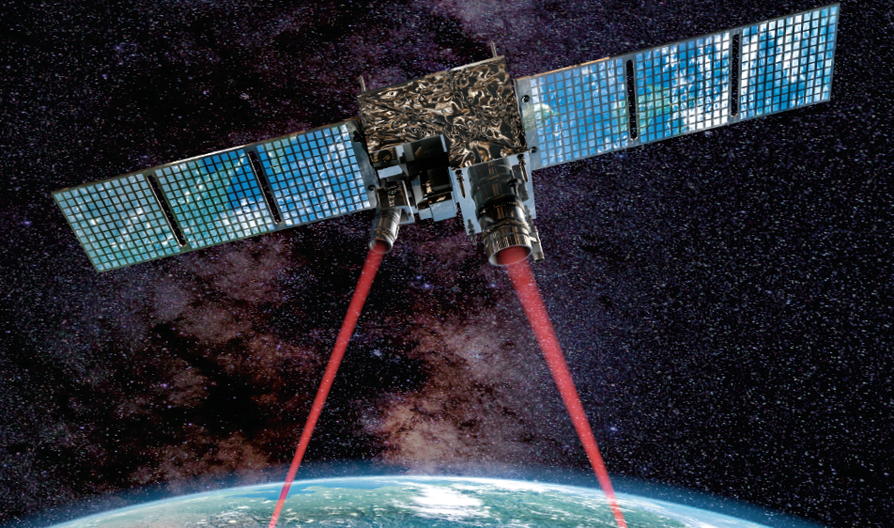
Chinese quantum satellite (launched 2016)
J. Yin et al., Science 356, 1140 (2017)
S.-K. Liao et al., arXiv:1707.00542
J.-G. Ren et al., arXiv:1707.00934
Bell test over 1200 km
Satellite-to-ground QKD at 1 kbit/s
Quantum teleportation over 1400 km
Slide taken from V.Makarov (http://www.vad1.com/)

Slide 14
Challenges & Developments
Challenges
Requires classical crypto, e.g. for authentication
Faint effects hard to implement
e2e encryption (mobiles?)
Standardization
Developments
Quantum Relays and Repeaters
Device-independent QKD (E91 protocol)
Multi-mode, quantum signatures, quantum one-way functions, …
Alice
Bob
RNG
$$+/×$$
RNG
$$+/×$$
RNG
$$0/1$$

Slide 15
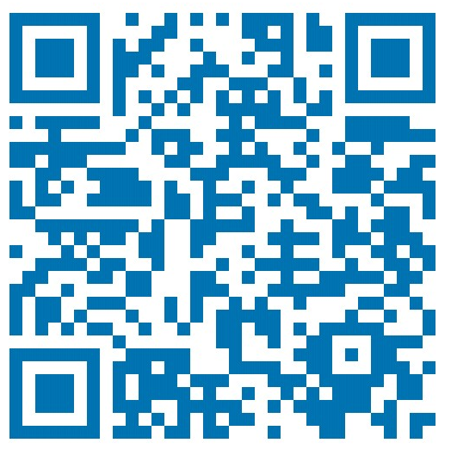
the end
Thank you for your attention!
Bye
You’re welcome ;-)
Alice
Bob
Eve
https://www.linkedin.com/in/hamsen/

